Slide 1
Graph Algorithms

Slide 2
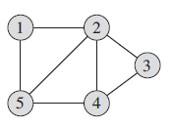
Graphs
A graph G = (V,E), V – set of vertices, E – set of edges (pairs of vertices).
V={1,2,3,4,5}
E={(1,2),(1,5),(2,5),(2,4),(2,3),(4,3),(4,5)}

Slide 3

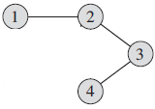
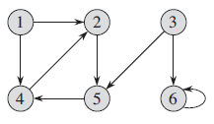
Graph terminology
Adjacent nodes: two nodes are adjacent if they are connected by an edge. 1 and 2 are adjacent nodes
Path: a sequence of vertices that connect two nodes in a graph. 1,2,3,4 is a path that connects 1 and 4.
Undirected graph: a graph where the edges have no direction.
Directed graph: a graph where the edges have a direction (or digraph). The order of vertices in edge is important.
Cycle: A path where v₁ = v_{n}. 2,5,4,2 is a cycle.

Slide 4
Graph terminology
Acyclic graph: graph containing no cycles of any length.
DAG: a directed acyclic graph.
Tree: a connected acyclic undirected graph.
Forest: an acyclic undirected graph (not necessarily connected), i.e., each connected component is a tree.

Slide 5
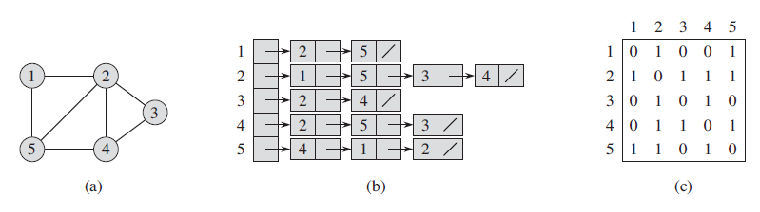
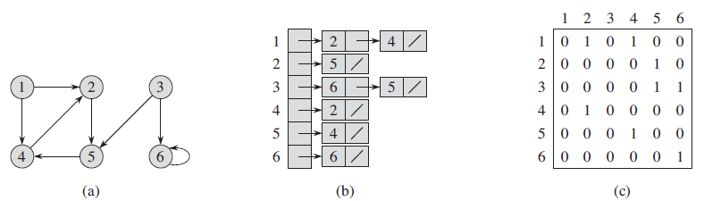
Graph representations
Adjacency-list representation of G=(V,E)
An array Adj of |V| lists, one list for each vertex.
Adj[u] = all the vertices v s.t. (u,v) is in E. // vertices that are adjacent to u
Adjacency-matrix representation of G=(V,E)
A matrix A = |V|*|V| s.t
1 if (i,j) is in E
0 otherwise
A_{ij}

Slide 6
Breadth-first search
Given G=(V,E) and a distinguished source vertex s, breadth-first search algorithm explores the edges of G to discover all vertices reachable from s.
It computes the distance (smallest number of edges) from s to each reachable vertex. Also produces ‘breadth-first tree’ with root s.
First discovers all vertices at distance k before discovering vertices at distance k+1.

Slide 7
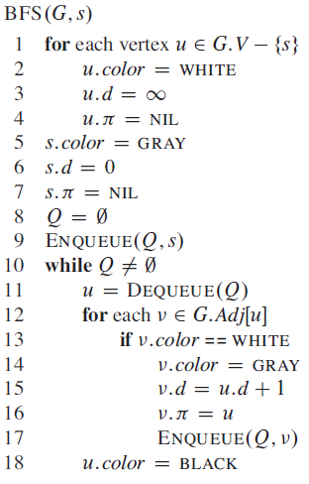
Breadth-first search

Slide 8
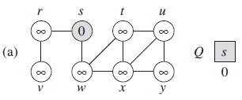
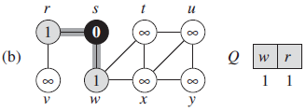
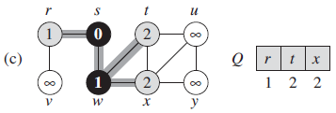
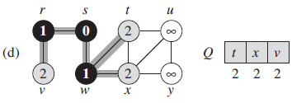
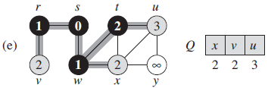
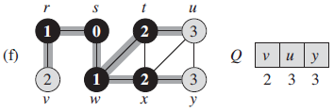
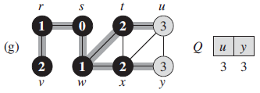
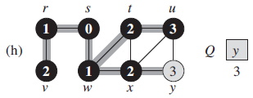
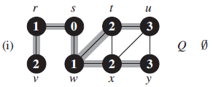
Breadth-first search

Slide 9
Running time of BFS
O(V)
Running time =O(V+E)
O(V + E)

Slide 10
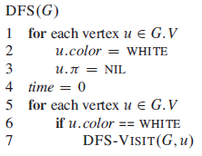
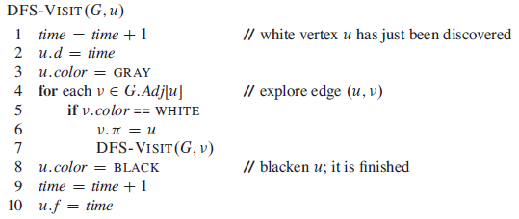
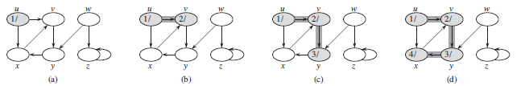
Depth-first search

Slide 11
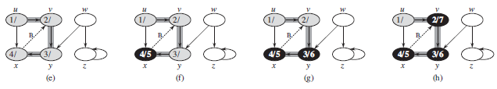
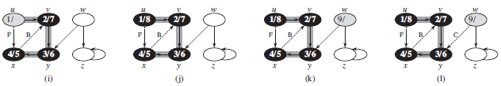
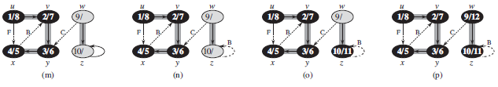
Depth-first search

Slide 12
Running time of DFS
Once for each vertex
O(V)
Sum (Adj(v)) = O(E)
Running time =O(V+E)

Slide 13
Topological sort
A sorting technique over Directed Acyclic Graphs (DAG).
It is a linear ordering of all vertices such that if (u,v) is an edge of G, then u appears before v in the ordering.
Common in ordering jobs or tasks.

Slide 14
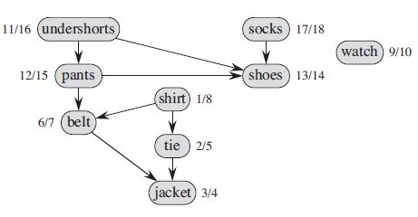
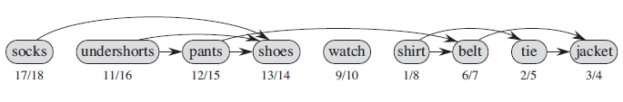
Topological sort

Slide 15

Topological sort
A job consists of 10 tasks with the following precedence rules:
Must start with 2, 4, or 7.
Tasks 1 and 3 must follow 4.
Tasks 3 and 6 must follow both 2 and 7.
8 must follow 6.
9 must follow 3 and 4.
10 must follow 8.
5 must follow 9.
Make a DAG, then run DFS

Slide 16
Topological sort
A job consists of 10 tasks with the following precedence rules:
Must start with 2, 4, or 7.
Tasks 1 and 3 must follow 4.
Tasks 3 and 6 must follow both 2 and 7.
8 must follow 6.
9 must follow 3 and 4.
10 must follow 8.
5 must follow 9.
1
9
5
4
3
2
8
10
6
7
4
1
2
7
3
9
5
6
8
10

Slide 17
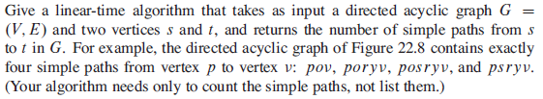
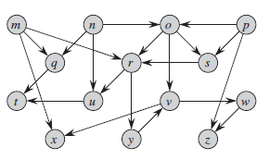
Exercise

Slide 18

Exercise

Slide 19
Minimum Spanning Trees
Problem: Laying water pipeline
Expensive

Slide 20
Minimum Spanning Trees
Problem: Laying water pipeline
The total length of pipes can be minimized
=> cheaper

Slide 21
Minimum Spanning Trees
A minimum spanning tree is a subgraph of an undirected weighted graph G, such that
it is a tree
It covers all the vertices V, contains |V| - 1 edges
the total cost associated with tree edges is the minimum among all possible spanning trees (not necessarily unique)

Slide 22
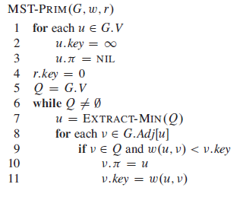
Prim’s MST Algorithm
Image taken from wikipedia

Slide 23
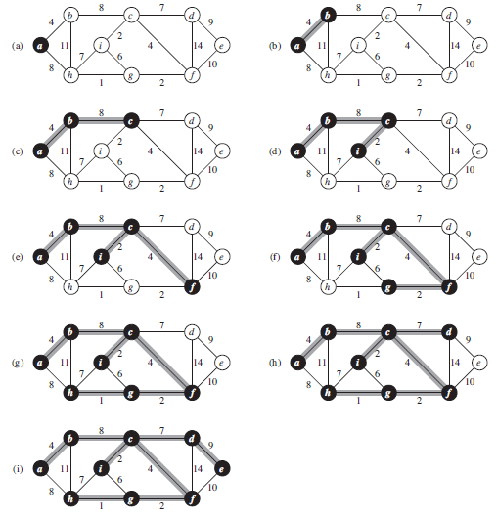

Slide 24
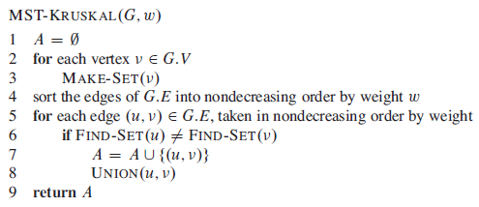
Kruskal’s MST Algorithm
Image taken from wikipedia

Slide 25
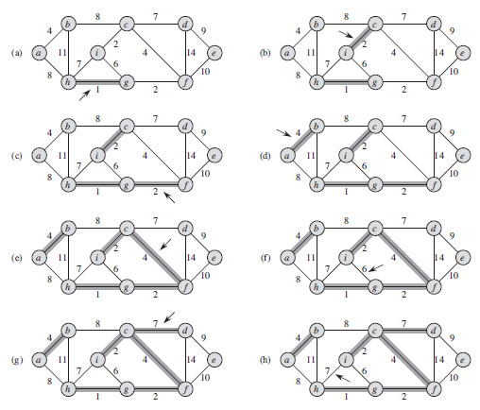

Slide 26
